Slide 1
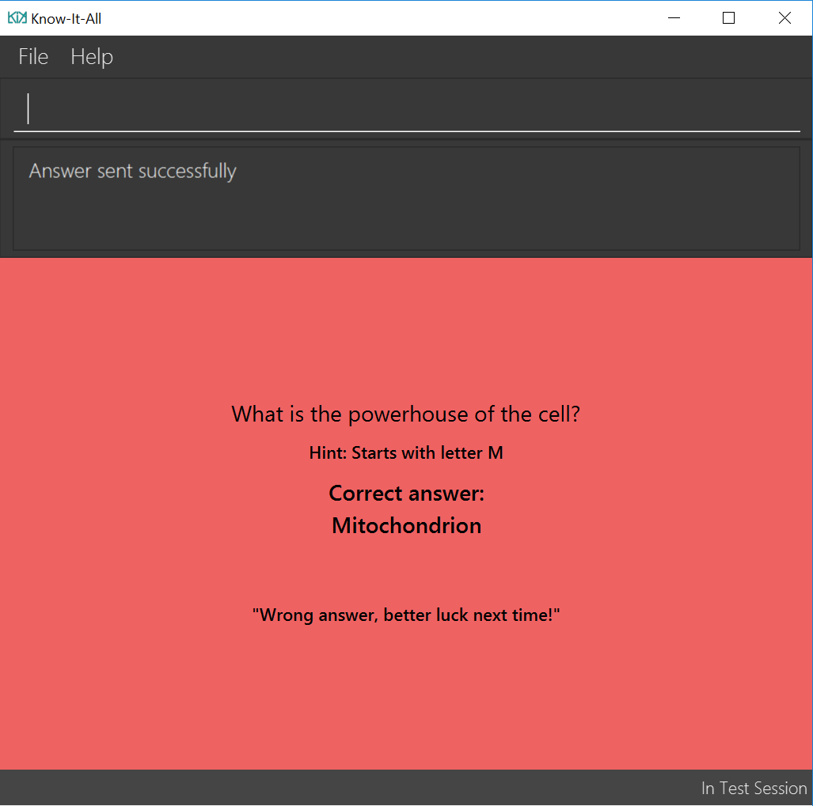
Indicate that attempted answer was submitted successfully
If the attempted answer is wrong, a red screen will appear with the
Question & hint (if any)
correct answer
wrong answer notification

Slide 2
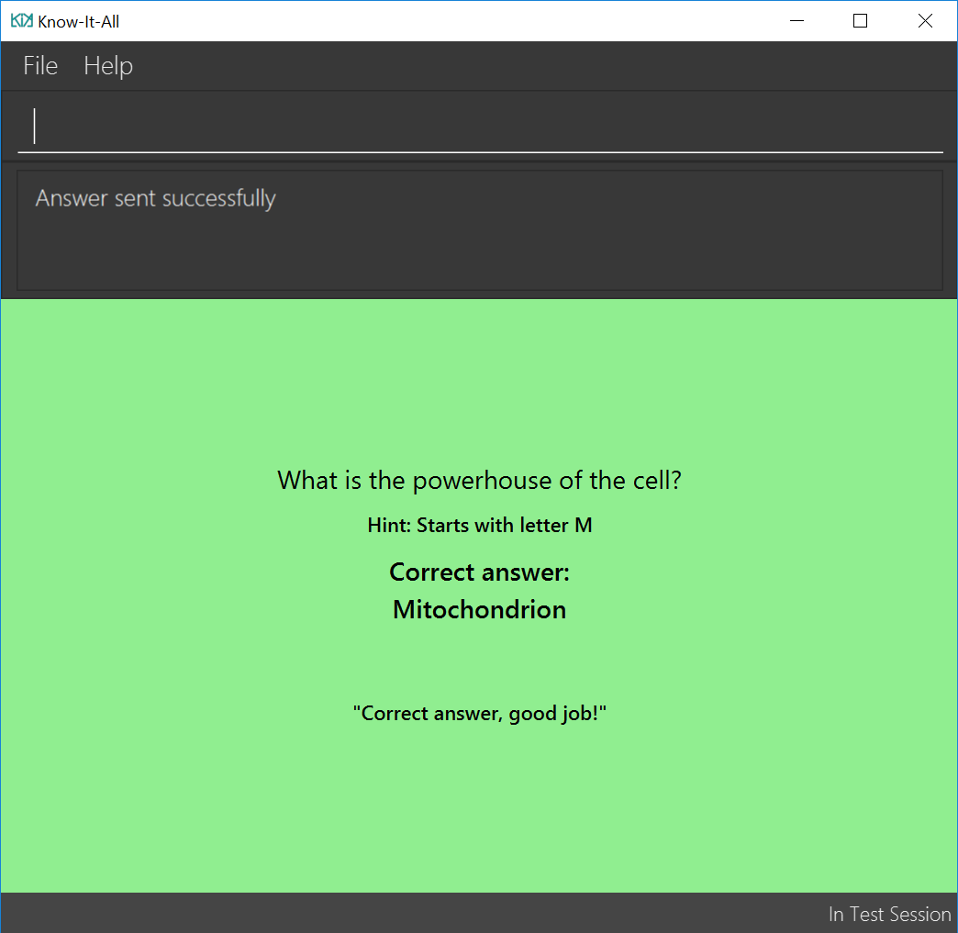
Indicate that attempted answer was submitted successfully
If the attempted answer is correct, a green screen will appear with the
Question & hint (if any)
correct answer
correct answer notification

Slide 3
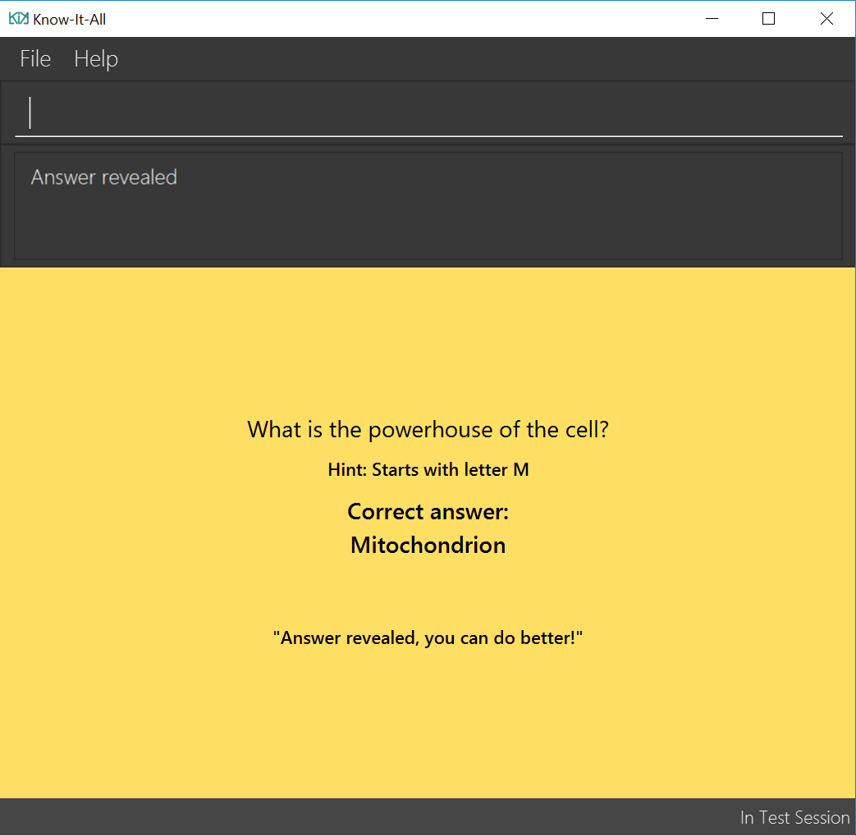
Indicate that answer is successfully revealed
If the answer is revealed, a yellow screen will appear with the
Question & hint (if any)
correct answer
revealed answer notification

Slide 4
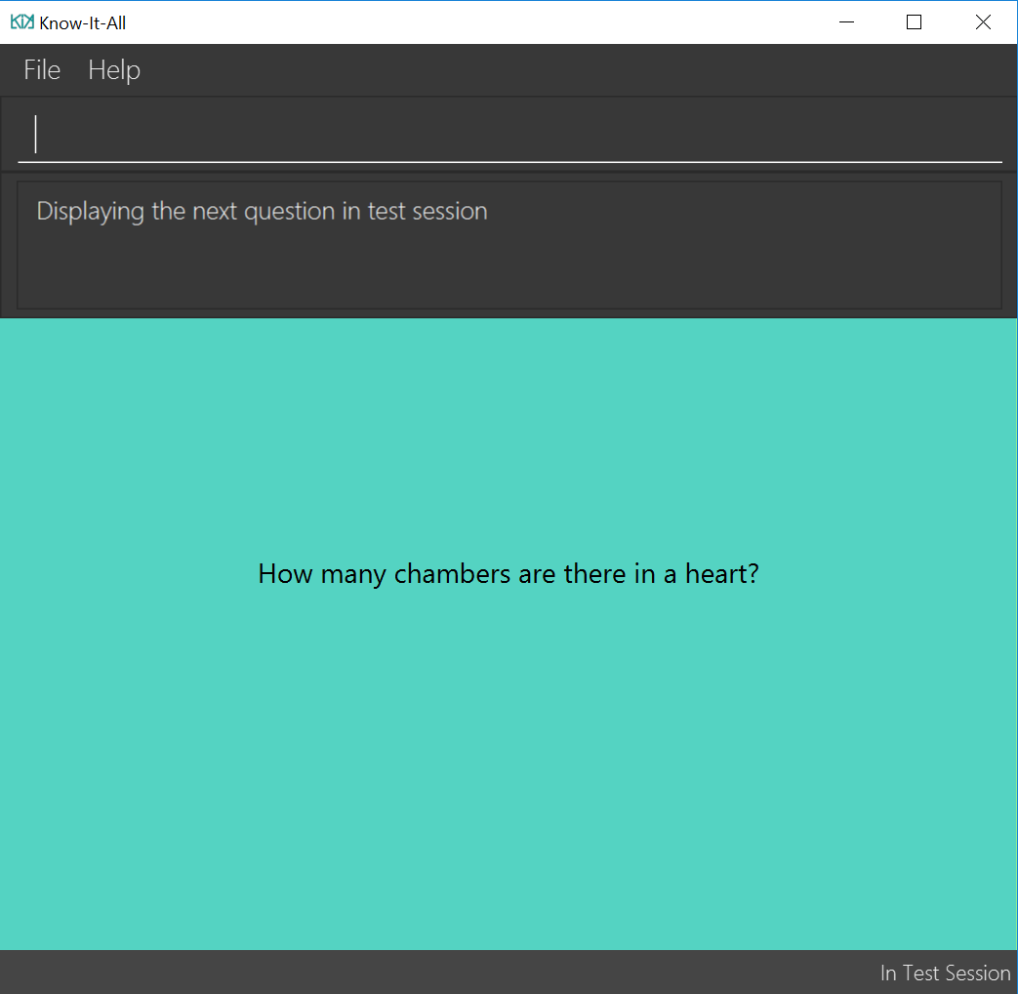
Indicate that next command is executed successfully
The next card question is displayed
Status bar shows that you are still in the test session

Slide 5
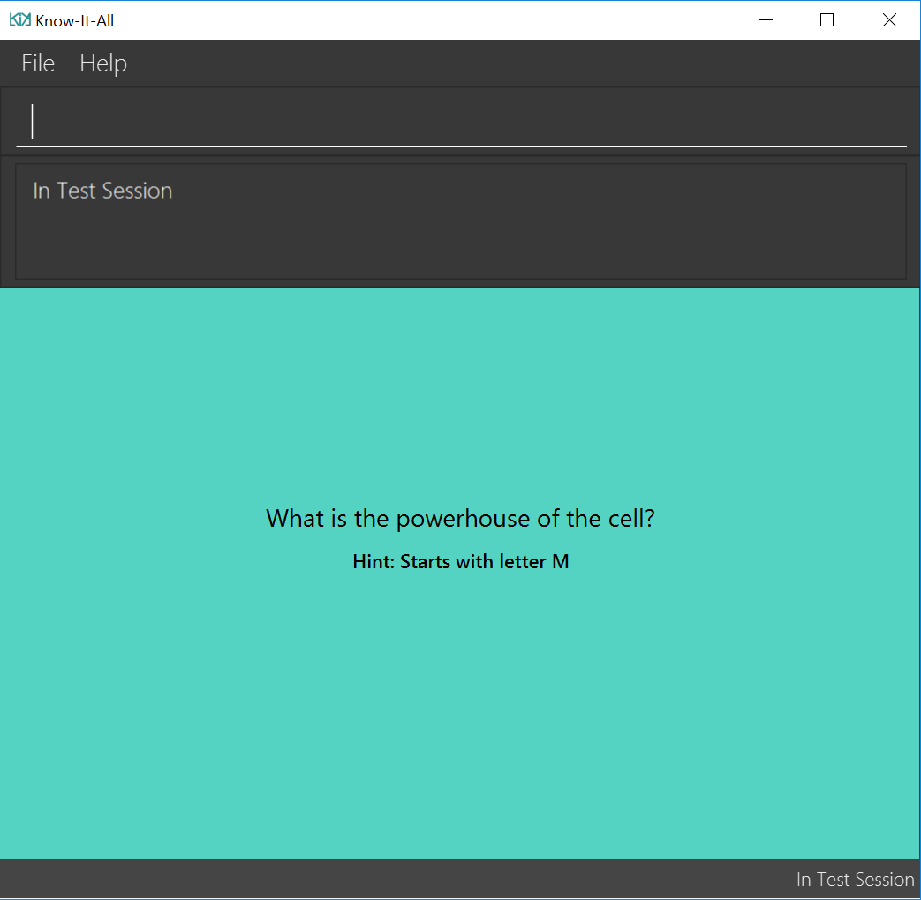
You have successfully entered the test session
Question and hint (if any) of the first card is displayed.
Status bar now states you are in the test session

Slide 6
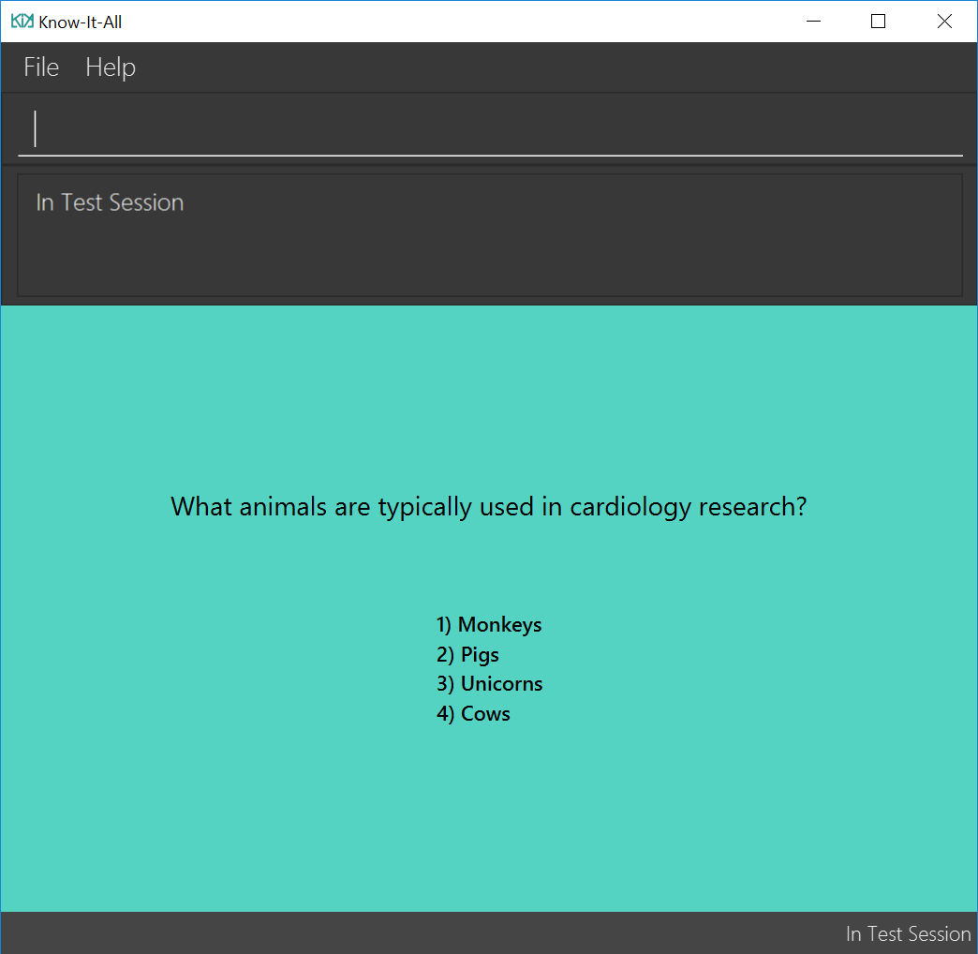
MCQ card options are displayed. One of them is the correct answer.

Slide 7
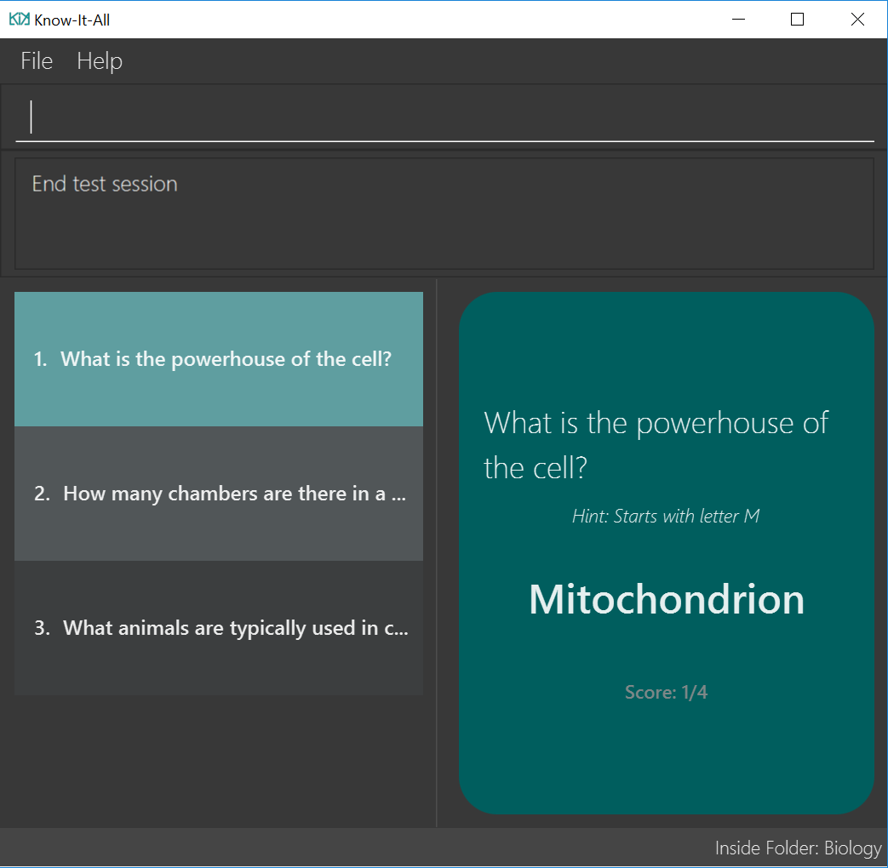
You have successfully ended the test session
Status bar now shows you are in back in the folder

Slide 8
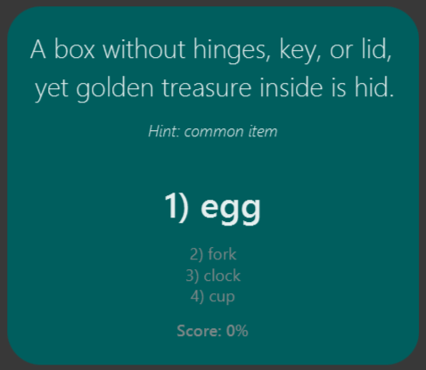
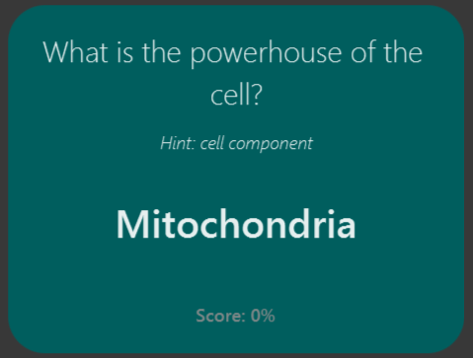
Incorrect options
Answer

